Slide 1
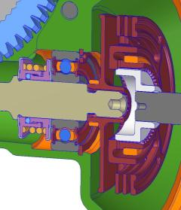
CCM-82: Shorter (Overlapping) Flex Coupler
Last updated: 08JN15
Description
Design a coupler that fits in reduced package for Fiat 329
Motivation : 4.0
Deliverables
Reduced Package
Assist mech durability
Acceptable NVH performance
Timing
Parts have been supplied from production tooling for all 4 components
Team Members/Customers
Team names: Dan Diffin
Customers: Applications teams, Fiasa, 1V5, etc….

Slide 2
CCM-82: Shorter (Overlapping) Flex Coupler
Last updated: 08JN15
Status Update:
7.58mm axially shorter than BMW coupler package
Coupler cost similar to BMW coupler
Requires larger clamp ring + $0.07
Requires PM adapter + $0.26
Parts tested at 90Nm (single cavity couplers and prototype adapters)
Parts pass over 4 lives
Interim PPAP approved for coupler 4 cavity tool
PM Adapter production tooling improved and 100% inspection added to address green cracks
Challenges:
PM Adapter supplier has added $0.14 to cost after addition of DSS and 100% crack inspection
Coupler PPAP is interim. Working on spline fit
Next Actions:
Address cost increase with supplier. Inspection is due to their issues and should not be at our cost.
Improving coupler spline thru process & tooling changes along with improving gaging

